Slide 1

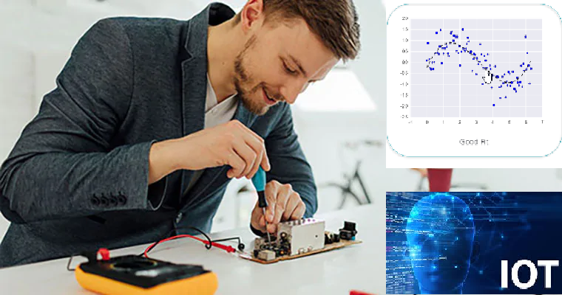



Wearable Devices and Computer Vision
Wednesday, July 06, 2020
Head Instructor: Jose Luis Ramirez Herran
TA’s: Souleymane Konate and Ricardo Villamil

Slide 2
Summary
Students are getting the hardware
Get started with the Sensor Tile development
Introduce the basic signal processing concepts
Introduce image processing – basic image operations
Lecture 4
Tutorial 1 Troubleshooting
Introduction to Machine Learning and Human Activity Recognition
Numpy, Pandas, Matplotlib and Scikit learn.
Last Class: Regression
Today’s:
More Machine learning supervised classification algorithms: SVM, PCA

Slide 3
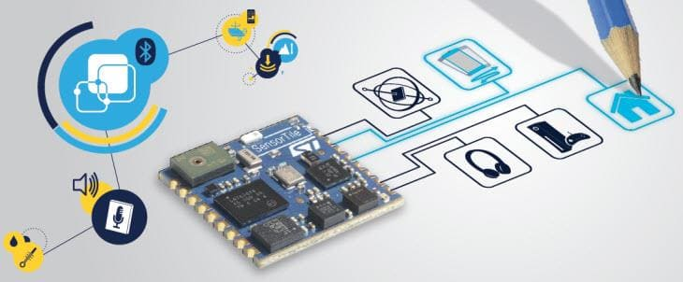
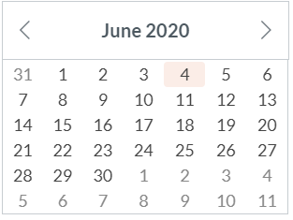
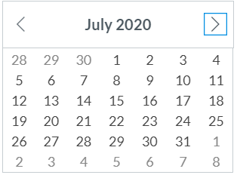
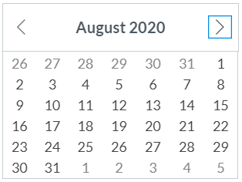
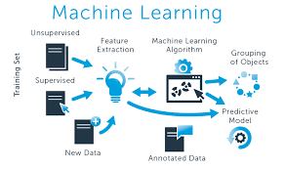
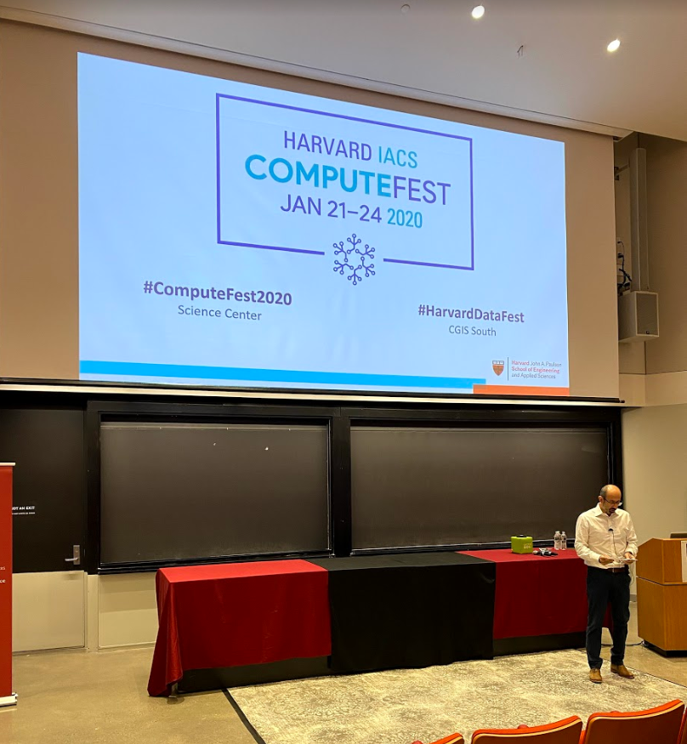
Calendar summer 2020
Mondays and Wednesdays 6:30 pm – 9:30 pm
Wearable Devices and Computer Vision
Project
presentations
Su M Tu W Th F S
SW+HW Setup.+ Basic Tutorials

Slide 4
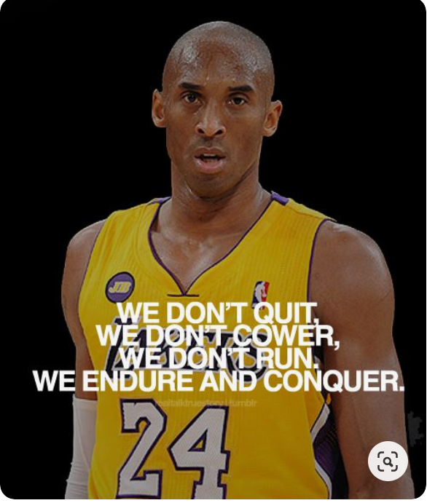
Today’s Lecture
Break
7:40 pm – 7:50 pm
Break
8:40 pm – 8:50 pm
Part 1
Part 2
Python for:
SVM using Python
Questions
Part 3
Optimizing of the Number and Placements of Wearable IMUs for Automatic Rehabilitation Recording
Questions?
Projects and Teams
Summary
Supervised Learning Classification Algorithms by Souleymane Konate
6:30 pm – 7:50 pm
7:50 pm – 8:40 pm
8:50 pm – 9:30 pm

Slide 5
Break
8:00 pm – 8:10 pm
6:30 pm – 8:00 pm
Part 1
Summary
Supervised Learning Classification Algorithms by Souleymane Konate

Slide 6
Today’s Lecture
Break
8:00 pm – 8:10 pm
Break
8:40 pm – 8:50 pm
Part 1
Part 2
Python for:
Part 3
Optimizing of the Number and Placements of Wearable IMUs for Automatic Rehabilitation Recording
Questions?
Projects and Teams
Summary
Regression Algorithms by Souleymane Konate
SVM using Python
Questions
6:30 pm – 8:00 pm
8:10 pm – 8:40 pm
8:50 pm – 9:30 pm

Slide 7
Presentation and Jupyter notebooks for SVM

Slide 8
Today’s Lecture
Break
7:40 pm – 7:50 pm
Break
8:40 pm – 8:50 pm
Part 1
Part 2
Python for:
Linear and Logistic Regression using Python
Questions
Part 3
Optimizing of the Number and Placements of Wearable IMUs for Automatic Rehabilitation Recording
Questions?
Projects and Teams
Summary
Regression Algorithms by Souleymane Konate
6:30 pm – 7:50 pm
7:50 pm – 8:40 pm
8:50 pm – 9:30 pm

Slide 9
Office hours
emails TA's:
sok462@g.harvard.edu
ricardo_villamil@fas.harvard.edu
Calendly me:
https://calendly.com/jlr682/wearable-devices-final-project

Slide 10
Troubleshooting tutorials in canvas
We have very effective office hours so far and we can show some videos were we solved specific problems related with the tutorials. Please take a look in Canvas and we hope this videos help you to get started with the sensorTile curriculum. They will be published into the canvas modules.

Slide 11
Questions?

